Slide 1
You are in it to Win it – A View from the OSDBU Side of the Desk
John Hale III,
Director
2nd Annual Native Hawaiian Organizations Association 2016 Business Summit
August 25, 2016

Slide 2
DOE’s Mission
Energy Security – Protection of high risk, high payoff RD&D of cleaner
more affordable and reliable alternate energy sources, e.g. Advanced
Research Projects Agency-Energy
Nuclear Security – National Nuclear Security Administration guards:
Military applications of nuclear energy
Military nuclear propulsion plants (i.e. nuclear submarines)
Nuclear Nonproliferation – Detect, secure, and dispose of
vulnerable nuclear weapons
Conversion of high grade to low grade Uranium
Computational analysis of nuclear warheads
Environmental Responsibility – Stop or reverse environmental
damage caused by our legacy of nuclear warhead production
Enhance Efforts in Scientific Discovery and Innovation – The Office of
Science is the largest single supporter of research in the physical sciences
2|

Slide 3
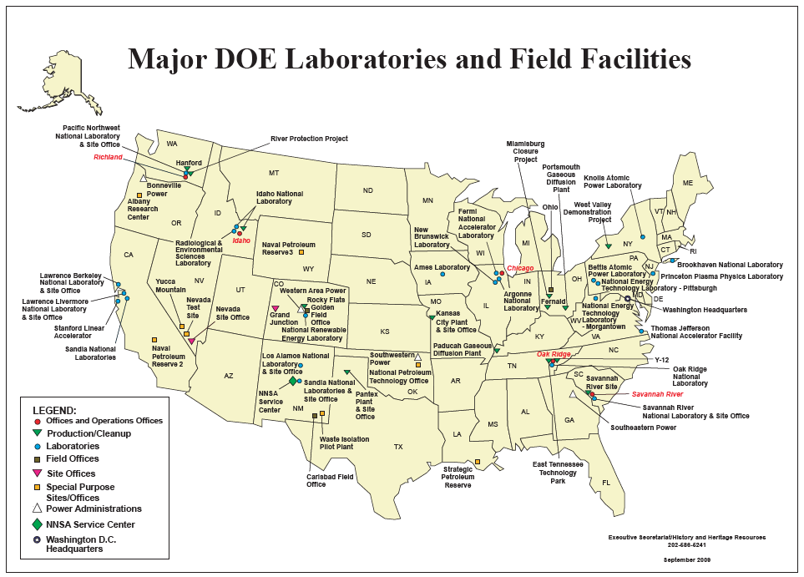
Site and Facility Management Contractors (FMCs)
3|

Slide 4
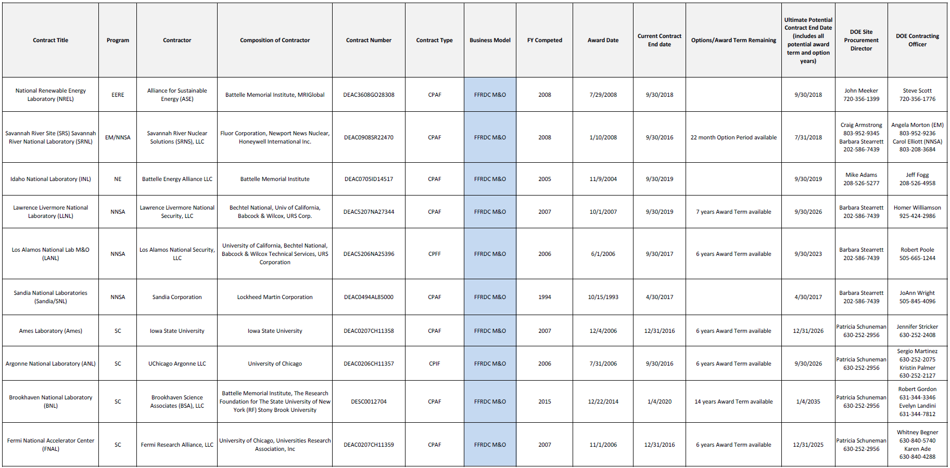
DOE/NNSA Site Facility Management Contracts
http://energy.gov/management/downloads/doe-nnsa-site-facility-management-contracts-june-2016
4|

Slide 5
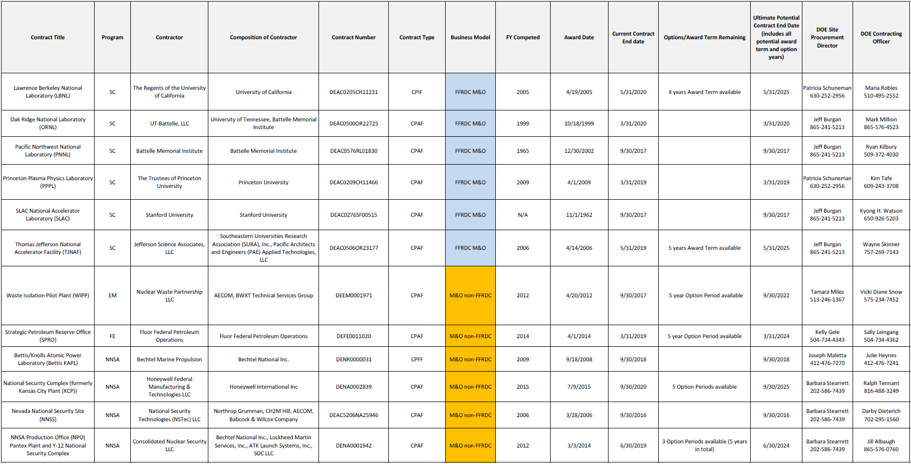
DOE/NNSA Site Facility Management Contracts
http://energy.gov/management/downloads/doe-nnsa-site-facility-management-contracts-june-2016
5|

Slide 6
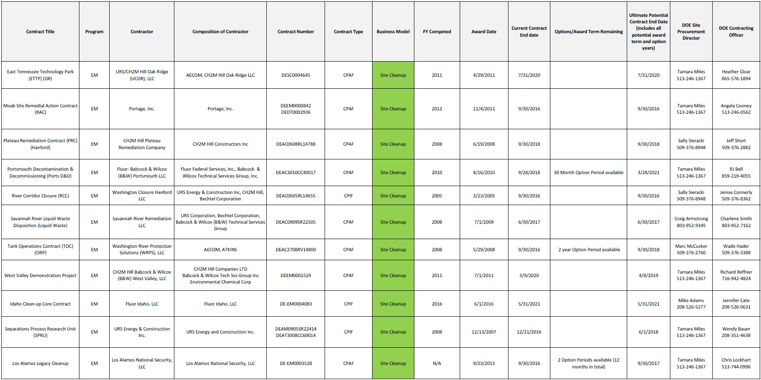
DOE/NNSA Site Facility Management Contracts
http://energy.gov/management/downloads/doe-nnsa-site-facility-management-contracts-june-2016
6|

Slide 7
DOE/NNSA Site Facility Management Contracts
http://energy.gov/management/downloads/doe-nnsa-site-facility-management-contracts-june-2016
7|

Slide 8
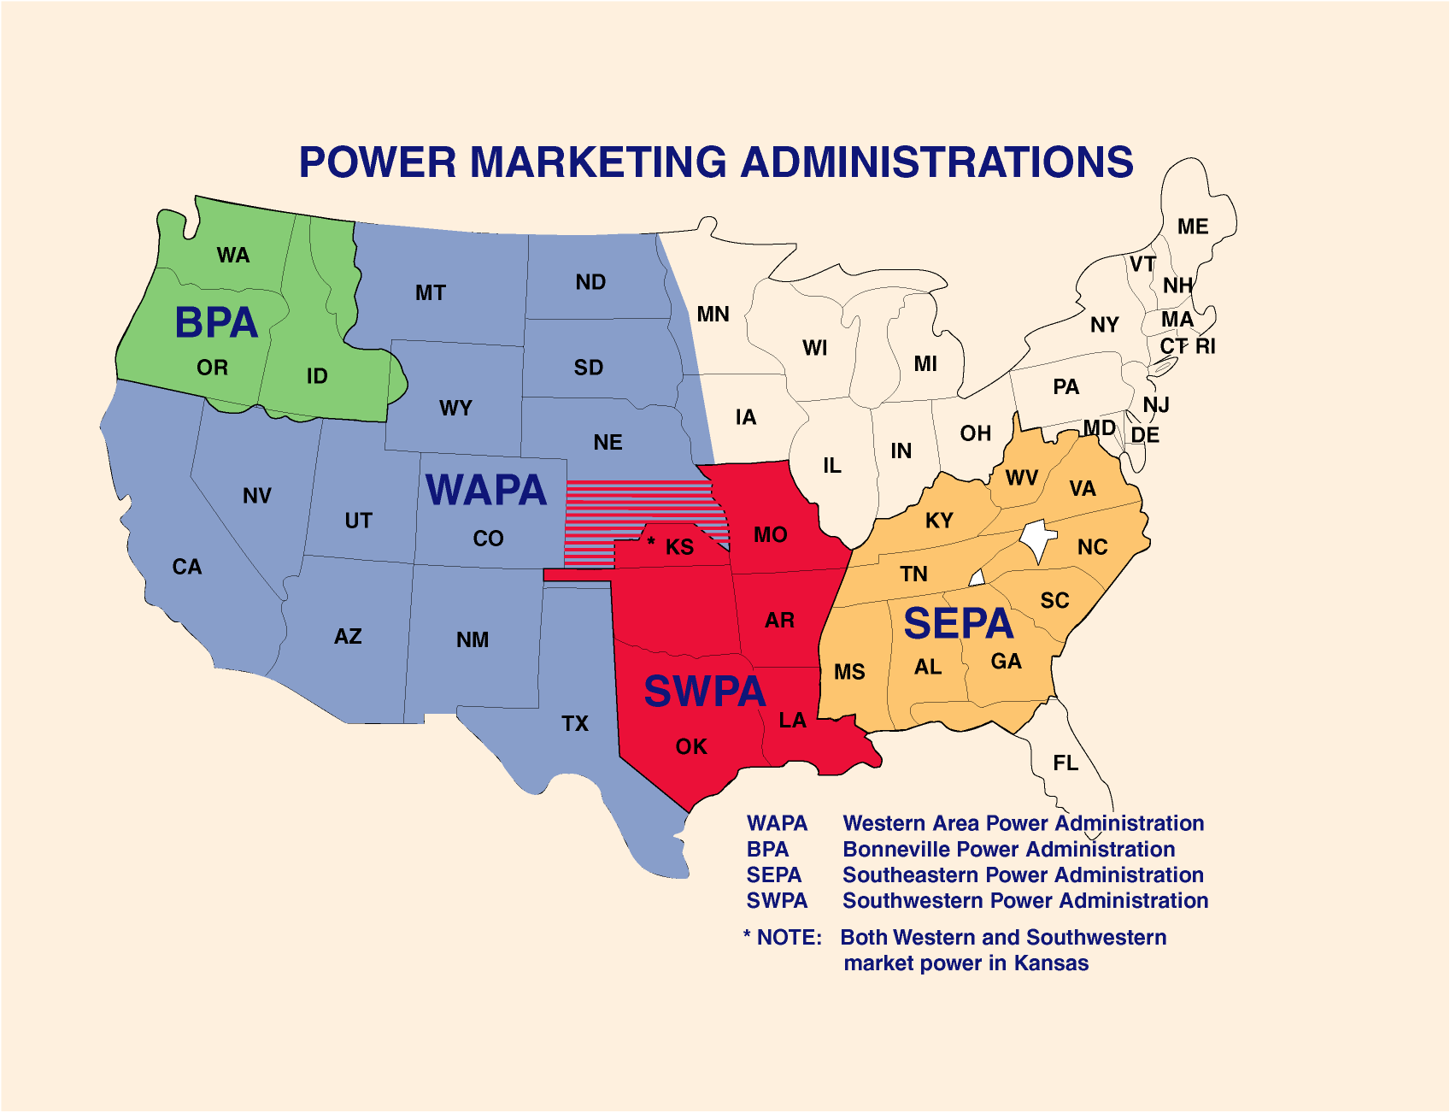
Power Administrations
8|

Slide 9
Power Administrations
Established in the early 1900s, sell excess electrical power produced at Federal water projects in order to repay the Government’s investment in the projects.
Bonneville Power Administration (BPA) – Headquartered in Portland, Oregon
Southeastern Power Administration (SEPA) – Headquartered in Elberton, Georgia
Southwestern Power Administration (SWPA) – Headquartered in Oklahoma
Western Area Power Administration (WAPA) – Headquartered in Colorado – services a 15 state region of central and western U.S.
9|

Slide 10
OSDBU’s Mission
“Building sustainable small business to enable the Department to achieve its mission through innovation and creativity”
Build corporate pipeline and efficient supply-chain
Plug-in small businesses to DOE opportunities
Small business made easy for program offices
OSDBU becoming program offices’ strategic partner
10|

Slide 11
OSDBU – Small Business Execution
Enable program offices to perform their mission and unexpected
challenges
Build corporate pipeline and efficient supply chain
Target effective and innovative small businesses
Plug-in small businesses to DOE opportunities
External stakeholder engagement
Transparency of opportunities
Small business made easy for DOE programs
DOE small business set-aside IDVs
Small business first policy
Core principle – small business first
Commitment to prime small business
Best value > commodity contracting
Defining characteristics of small businesses
Creativity
Innovation
Agility
Niche capabilities
U.S. DEPARTMENT OF ENERGY | OFFICE OF SMALL AND DISADVANTAGED BUSINESS UTILIZATION | August 25, 2016
11|

Slide 12
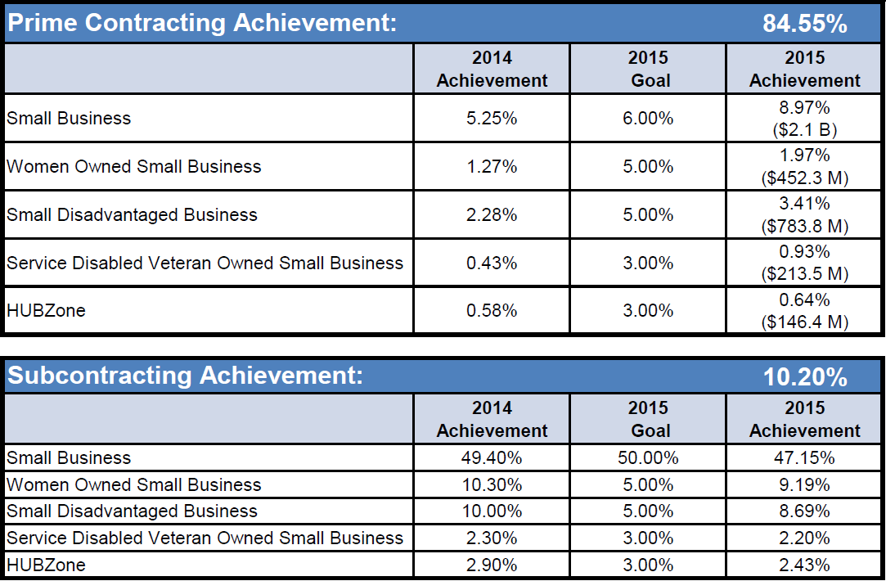
DOE FY2015 Small Business Scorecard A
http://smallbusiness.data.gov
12|

Slide 13
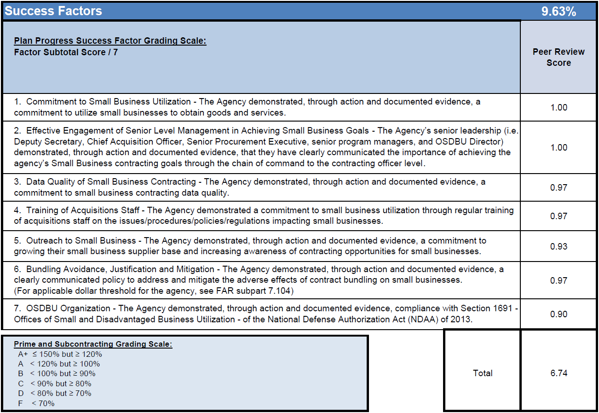
DOE FY2015 Small Business Scorecard
http://smallbusiness.data.gov
13|

Slide 14
Discriminating Factors
How to help distinguish yourself from the competition
Federal Procurement Data System-Next Generation (FPDS-NG). Does DOE buy your goods and services?
What are Federally Funded Research and Development Centers (FFRDCs), Management & Operating Contracts (M&Os), and Facility Management Contracts (FMCs)? Why are they particularly important for DOE?
What is the significance of the Consolidated Appropriation Act of 2014 Section 318?
What is the National Defense Authorization Act (NDAA)?
Inspector General and General Accounting Office reports
Data.gov
Management & Operating Subcontract Reporting Capability (MOSRC)
President’s budget request
DOE leadership budget hearing
DOE leadership YouTube videos, etc.
OSDBU Council – Personnel, outreach events, etc.
14|

Slide 15
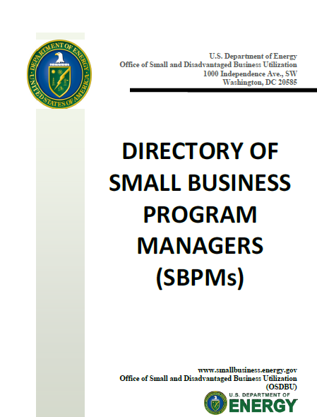
Rules of Engagement
Engage with program elements. Know their mission and requirements.
Create a demand by becoming a solution to DOE requirements, instead of just fishing for work.
Attend outreach sessions and network with other contractors.
Plan ahead – allow 1.5 to 2 years to prepare a proposal for major requirement.
Response to sources sought synopses.
Consider teaming arrangements if requirements are steep.
Learn how to prepare an effective proposal.
Incumbents do not always win recompetitions.
Contact Procurement Technical Assistance Centers (PTACs) if you need help.
Be persistent.
15|

Slide 16
DOE Forecast Opportunities
To download a copy of the acquisition forecast in spreadsheet format, go to www.smallbusiness.energy.gov.
16|

Slide 17
16th Annual DOE Small Business Forum and Expo
May 16-18, 2017
Sheraton at Kansas City Hotel at Crown Center
2345 McGee Street
Kansas City, MO 64108
17|

Slide 18
Thank You!
John Hale III, Director
Office of Small & Disadvantaged Business Utilization
DOE OSDBU and Forecast Websites:
www.smallbusiness.energy.gov
Email Us:
smallbusiness@hq.doe.gov
Call Us:
(202) 586-7377
18|

