Slide 1
Effectively Doing Business with the Federal Government Alice Williams Associate Director Workforce Initiatives, Socioeconomic Programs & RIF DoD Office of Small Business Programs

Slide 2
Agenda
Introduction
What Type of Business am I
Socioeconomic Programs (8a, WOSB, SDVOSB, HUBZone)
Initial Steps Small Businesses Should Take
Federal Supply Classification Code (FSC)/ Product Service Code (PSC)
North American Industry Classification Code (NAICS)
SBA Size Standard
Am I Prepared to Do Business with DoD
Step 1: DUNS
Step 2: SAM
Who in DoD Buys what I Sell
Finding Contracting Opportunities
Small Business Professionals
How Do I Market My Product
Marketing Presentations
Data Analysis
Where Can I get Help
Resources

Slide 3
What Type of Business Am I
Socioeconomic Programs (8a, WOSB, SDVOSB, HUBZone)
Small Disadvantaged Business/8a:
Small firm must be at least 51% owned and controlled by a socially and economically disadvantage individual(s)
Meet small business size standards
In business for more than two years
Unconditionally owned and controlled by one or more disadvantaged individuals who are US citizens
Women-Owned Small Business:
Must meet small business size standards
51% owned and controlled by one or more women who are US citizens
Ownership must be direct and not subject to limitations
Woman or women must manage day to day operations
Service-Disabled Veteran-Owned Small Business:
Must have a service-connected disability that has been determined by the Department of Veterans Affairs or Department of Defense
Must meet small business size standards
51% owned and controlled by a service disabled veteran
Daily management operations of the concern must be controlled by a service-disabled veteran or caregiver
Historically Underutilized Business Zone:
Meet small business size standards
Owned and controlled by at least 51% of US citizens, or a Community Development Corporation, and agricultural cooperative, or an Indian tribe
Principal office must be in a designated HUBZone
At least 35% of the firm’s employees must live in a HUBZone
Notes:
There are four different types of businesses under the Socio-economic program. There’s the 8A or Small Disadvantaged Business, Women owned small business, Service-disabled veteran-owned small business, and Historically Underutilized Business Zone (HUBZone).
SDB/8A
The 8(a) Business Development Program is designed to assist eligible socially and economically disadvantaged small businesses by providing qualified firms access to capital and credit, business counseling and training, and contracting opportunities. Socially disadvantaged is defined as African-Americans, Hispanic Americans, Asian Pacific Americans, Native Americans and Subcontinent Asian Americans. To qualify for an 8a business, you must be:
-Be a small firm and 51% owned and controlled by a socially and economically disadvantaged individual
-Meet small business size standards
-In business for more than two years
-Unconditionally owned and controlled by one or more disadvantaged individuals who are US citizens
WOSB
The purpose of the WOSB Program is to ensure women-owned small business concerns have an equal opportunity to participate in Federal contracting and to assist agencies in achieving their women-owned small business participation goals. To participate in the WOSB program, a business must:
-Must meet small business size standards
-Be 51% owned and controlled by one or more women who are US citizens
-Ownership must be direct and not subject to limitations
-A woman or women must manage the day to day operations
SDVOSB
The purpose of the Service-Disabled Veteran-Owned Small Business Program is to provide Federal contracting assistance to service-disabled veteran-owned small business concerns. In order to qualify for the SDVOSB program, you must:
-Have a service-connected disability that has been determined by the Department of Veterans Affair or Department of Defense
-Must meet small business size standards
-Be 51% owned and controlled by a service-disabled veteran
-And daily management operations of the concern must be controlled by a service-disabled veteran or caregiver
HUBZone
The purpose of the HUBZone Program is to provide Federal contracting assistance for qualified small business concerns located in historically underutilized business zones (designated by the SBA), in an effort to increase employment opportunities, investment, and economic development in those areas. To meet the qualifications for the HUBZone program, a business must:
-Meet small business size standards
-Be owned and controlled by at least 51% of US citizens, or a Community Development Corporation, or an Indian tribe
-The principal office must be in a designated HUBZone
-And At least 35% of the firm’s employees must line in a HUBZone

Slide 4
Initial Steps Small Business Should Take
Identify your product or service.
Determine your Federal Supply Classification Code (FSC) or Product Service Code (PSC). Example: D302 ADP Systems Development Services.
www.dlis.dla.mil/h2
www.fbo.gov
Identify your North American Industry Classification Codes (NAICS).
Determine your NAICS code. Example: 541512 Computer Systems Design Services.
www.census.gov/eos/www/naics
Identify your Small Business Administration (SBA) Size Standard.
Determine your size standard. Example: 541512 $25M average annual receipts preceding 3 years.
There is a separate size standard for each NAICS.
www.sba.gov/category/navigation-structure/contracting/contracting-officials/eligibility-size-standards
Notes:
Now lets talk about the initial steps you should take to do business with the federal Government. The first thing you need to do after identifying what type of business you are, is to identify your product or service by determining your Federal Supply Classification code or Product Service Code. Federal Supply Codes are four digit codes that are used by the Government to describe the products, services, and research and development purchased by the government. You can go to either one of these websites to find your codes.
Next you want to identify your North American Industry Classification Code (NIACS). NAICS codes are a six digit coding system used to classify business establishments for the purpose of collecting, analyzing, and publishing statistical data related to the US economy. NAICS organizes establishments into industries according to the similarity in the processes used to produce goods or services. The SBA uses NAICS codes as a basis for its size standards. You can find your NAICS code by visiting census.gov/eos/www/naics.
Next you want to determine your small business size standard. A size standard represents the largest size that a business may be to remain classified as a small business for SBA and federal contracting programs. The definition of “small” varies by industry or NAICS code. To help determine your small business size standard, visit the website listed above.

Slide 5
Am I Prepared to do Business with DoD
Step 1: Obtain a Data Universal Numbering System (DUNS) number.
Unique nine-digit identification number required to register with the federal government for contracts or grants.
What do I need to get my DUNS Number?
Legal name
Headquarters name and address for your business
Doing Business As (DBA) or other name by which your business is commonly recognized
Physical address, City, State and ZIP Code
Mailing address (if separate from headquarters/physical address)
Telephone number
Contact name and title
Number of employees at your physical location
Whether you are a Home-Based Business
How do I get my DUNS Number?
Call 866-705-5711
Web requests: fedgov.dnb.com/webform/
Notes:
Next we want to ask ourselves “Am I prepared to do business with DoD?” The first step to preparing is obtaining a DUNS number. A DUNS number is a unique nine-digit identifier issued and maintained by D&B (Dun & Bradstreet), that verifies the existence of a business entity globally. D&B assigns DUNS numbers for each physical location of a business, and the good news is it’s absolutely free. A DUNS number is required to register with the federal government for contracts or grants.
So, What do I need to get my DUNS number?
Legal name
Headquarters name and address for you business
Doing Business As (DBA) or other name by which your business is commonly recognized
Physical address, City, State and Zip Code
Mailing address (if separate from headquarters or physical address)
Telephone number
Contact name and title
Number of employees at your physical location
Whether you are a Home-Based Business
How do I get my DUNS Number?
You can get your DUNS number by calling the number here and receive your number in about 10 minutes, or you can do a web request which is about a day turn around.

Slide 6
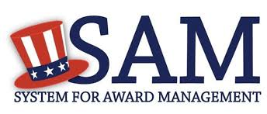
Am I Prepared to do Business with DoD
Step 2: Register your Business with the System for Award Management (SAM).
This system consolidates the capabilities of existing Federal procurement systems including:
Central Contractor Registry (CCR)
Federal Agency Registration (FedReg)
Online Representation and Certification Application (ORCA)
Excluded Parties List System (EPLS), or companies excluded from doing business with the government
How do I get registered?
www.sam.gov
Notes:
Step 2 is to register your business with the System for Award Management (better known as SAM). SAM is the federal governments primary database of vendors that does business with the government. This system consolidates the capabilities of other existing federal procurement systems including: the Central Contractor Registry, the Federal Agency Registration, Online Representation and Certification Application, and Excluded Parties List System. The system is also used as a marketing tool for businesses. SAM allows government agencies and contractors to search for your company based on your ability, size, location, experience, ownership and more. Registration in SAM is sometimes referred to as “self-certifying” your small business. You must be registered in SAM prior to the award of any contract, basic ordering agreement, or blanket agreement.
How do I get registered?
To register in SAM, go to www.sam.gov.

Slide 7
Who in DoD Buys What I Sell
Finding Contracting Opportunities
Federal Business Opportunities (FedBizOpps)
www.fbo.gov.
www.usaspending.gov
Small Business Professionals
Located at every agency that exercises contracting authority.
Defense agencies' small business program offices
www.acq.osd.mil/osbp/offices/index.shtml
Notes:
Who in DoD buys what I sell?
The absolute best way to find contracting opportunities is to visit the Federal business Opportunities website at www.fbo.gov. DoD and all federal contracting activities synopsize proposed requirements and contract awards greater than $25,000 in FedBizOpps. You can also check out usaSpending.gov. This site was created to establish a single searchable website, accessible to the public at no cost, that includes the name and location of the entity receiving the award, the amount of the award, the NAICS code, and the funding agency.
DoD Small Business Professionals (SBPs) are also a great source of guidance on which agencies may want to consider procuring your product or service. These professionals are located at every DoD agency that exercise contracting authority. A list of Small Business offices can be found at the above website.

Slide 8
How Do I Market My Product
Marketing Presentations
Have two marketing presentations ready at all times.
One-page capability sheet
Company Name, website, contact info, locations, small business categories, and CAGE code
Certifications
NAICS code
DoD/Federal, state, and local contracts with point of contact
Significant subcontracts with point of contact
Government Services Administration (GSA) contracts, if any
Full capability presentation
Know your audience
Be focused and brief
Articulate how the customer will benefit from doing business with you
Identify the problems you will solve for the customer
Notes:
How do I market my product?
First and foremost, you must have a marketing presentation. As a matter of fact, its best to always have two ready at all times. You need to have a one-page capability sheet, and a full capability presentation.
Your capability sheet should consist of the following things:
Company name, website, contact info, locations, small business categories, and CAGE code
Certifications
NAICS code
DoD/Federal, state, and local contracts with point of contact
Significant subcontracts with point of contact
Government Services Administration (GSA) contracts, if any
Now for your full capability presentation, you want to know you audience. Be focused and brief, let the customer know how they will benefit form doing business with you, and identify the problems you will solve for them.

Slide 9
Data Analysis
DoD Small Business Statistics & Analysis

Slide 10
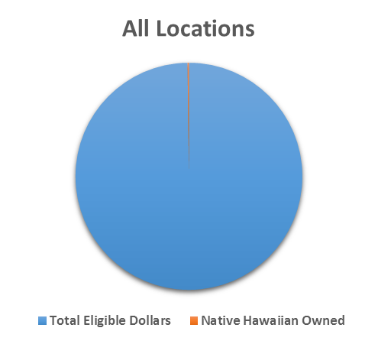
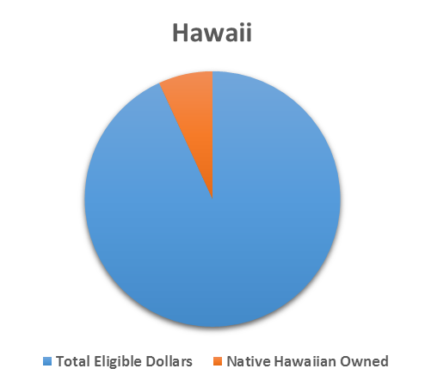
FY 2015 DoD Prime Contracting by Place of Performance Total Eligible vs. Native Hawaiian Owned
Data Source: FPDS-NG by Awarding Department

Slide 11
FY 2015 DoD Prime Native Hawaiian Owned Prime Contracting by Component / Agency
Data Source: FPDS-NG by Awarding Department (may not total 100% due to deobligations)

Slide 12
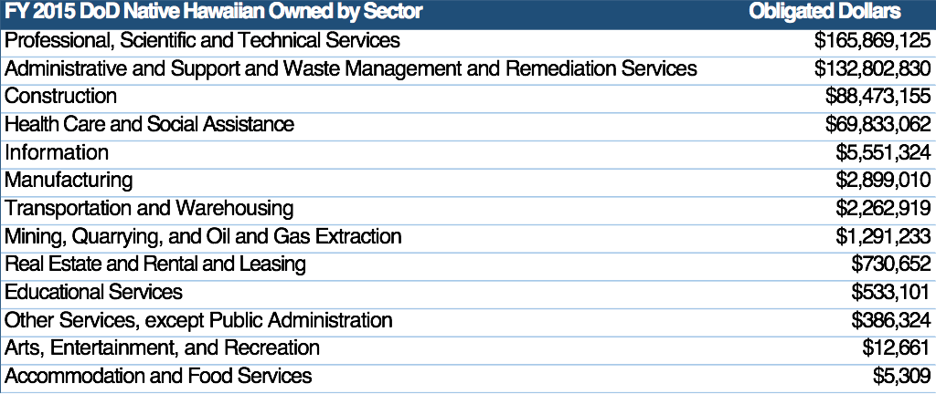
FY 2015 DoD Prime Native Hawaiian Owned Prime Contracting by NAICS Sector
Data Source: FPDS-NG by Awarding Department (may not total 100% due to deobligations)

Slide 13
Where Can I Get Help
Resources
Local Resources
Small Business Administration
www.sba.gov
Small Business Learning Center
www.sba.gov/tools/sba-learningcenter
Small Business Development Centers
www.sba.gov/sbdc
Business USA
www.business.usa.gov
The Service Corps of Retired Executives (SCORE)
www.score.org
Procurement Technical Assistance Centers (PTACs)
www.dla.mil/smallbusiness/pages/ptap.aspx
DoD Small Business Programs Offices
www.acq.osd.mil/osbp/offices/index.shtml
Small Business Administration
www.sba.gov/hi
SBA District Office -
500 Ala Moana Boulevard, Suite 1-306
Honolulu, HI 96813
808-541-2990
Procurement Technical Assistance Center (PTAC)-Hawaii Office
711 Kapi’Olani Boulevard, Suite 1450
Honolulu, HI 96813
808-596-8990

Slide 14
Questions

